Slide 1


Unleash the Power of SQL: A Hacker's Database
Dive into the world of SQL with a database designed for speed, flexibility, and cross-platform compatibility. Perfect for beginners and seasoned hackers alike.
by Harshit Mishra

Slide 2


Slide 3
Why Choose This SQL Database?
Lightweight
Cross-Platform
Fast & Smooth
Works on low-end devices, minimizing resource usage.
Runs seamlessly on Windows, Linux, and Android.
Delivers a lag-free experience, even on mobile.

Slide 4




Three Versions to Suit Your Style
CLI
CLI EXE
SQL GUI
For terminal aficionados.
Windows-only, no install needed.
Visual interface for ease of use.

Slide 5

CLI: Command-Line Interface
Platforms
Installation
Usage
Windows, Linux, Android.
Simple command-line setup.
Direct SQL query execution.
Practice Quiz
Help, Tip's, FAQ, Developer's Support

Slide 6

CLI EXE: Windows Power
1
Direct Execution
2
Portable
3
Beginner-Friendly
No manual setup required.
Lightweight and easy to move.
Quick start for Windows users.
4
Practice Quiz
5
Help, Tip's, FAQ, Developer's Support

Slide 7

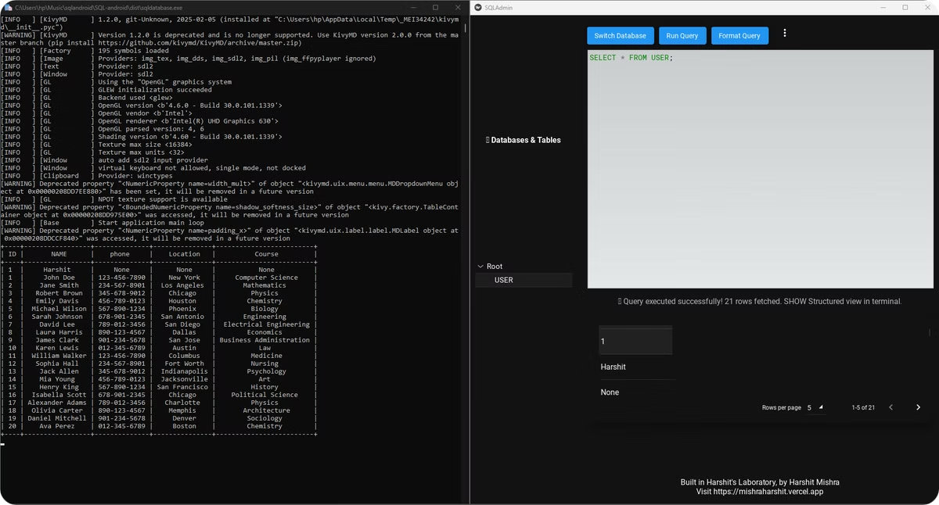
SQL GUI: Visual Interface
1
Easy-to-Use
Intuitive interface.
2
Click-Based
No need to remember commands.
3
Beginner-Friendly
Visual approach to SQL.

Slide 8




Download from GitHub
All Versions
Other Projects
Easy Access
Find CLI, CLI EXE, and GUI.
Explore more cool tools.
One-click downloads available.

Slide 9
Conclusion: Your SQL Solution
Cross-Platform
1
Any device, any OS.
Easy to Use
2
Simple setup.
Free
3
Open source.

Slide 10

Thank You!
Any questions? Let's discuss!

